Slide 1
Project GIJIMA
14 March 2024
Note: Add Mine specific photo
Kusasalethu Mine

Slide 2
Project Gijima Overview
INPUT DATA
STRATEGY - PLAN - EXECUTION
SUCCESS MEASURE
Systemic
Face time optimization
Bonus
People
Give our people enough time to safely execute their work
Just Culture
Infrastructure
OPERATIONAL INFORMATION
HRM related data
TTT – crew feedback reports
Other relevant data
Strategy
Central Service support
Develop self
Reach our S300 targets
Just culture
Equipment
Develop others
Take people along
Engaged workforce
Adopt a crew
Thibakotsi routines

Slide 3
Kusasalethu gijima journey
Securing the Mine
Turnkey infrastructure and equipment projects
Increased engagement with prioritization of ownership and personalization of journey
Empowerment and coaching culture with MMSEP as key driver
Analysis and Feedback
Establishment of routines and planning cycles
Shaft Time Optimization
Sustaining performance through continuous improvement
STRATEGY - PLAN - EXECUTION
SUCCESS MEASURE
“Excellence is not an act but a habit formed over time”
Systemic
Face time optimization
Bonus
People
Give our people enough time to safely execute their work
Just Culture
Infrastructure
Strategy
Central Service support
Develop self
Reach our S300 targets
Develop others
Just culture
Equipment
Reinforcing Humanistic culture transformation programme
Take people along
Engaged workforce
Adopt a crew
Thibakotsi routines
Notes:
Proposed to include HRM and Wellness into one integrated journey

Slide 4
Safety indices
Analysis | Drivers | Change / Focus
Fewer high energy incidents occurring (RBE & Winch related) | Incidents are mainly behavior related | During VFL focus on winch conditions
Slip and falls | Poor housekeeping Accumulation of mud due to crew | Initiated campaign on “What good looks like” Look at additional mud loading crews
FOG (Gravity and Seismic) | Covered under Rock Engineering

Slide 5
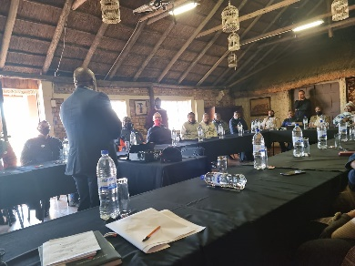
Thibakotsi TEAM TRAINING IMPACT
Training commenced in July 2022 and all crews have completed workshop 1 (incl stoping, developing, tramming, vamping and equipping, construction and contractors). Workshop 2 commenced in December with 37 Crews completed to date
Preparation
Crew demographic packs
Role profiles per individual
Safety, Rock Engineering and Ventilation reports
Accident statistics
Crew performance (S300)
Crew satisfaction survey
Feedback from crews
Stopes and boxes full of ore
Insufficient support material
Fatigue
Delays in bonus payments
Backfill standard not always followed
Workplace temperatures to high
PPE wears out sooner than 3 mnts
Pledges
Conduct entry examinations as an entire team
Address and closing of hazards
Improve respect amongst team members and development unity within the team
Stop rushing for the cage
Absenteeism - agreement to manage overtime better and stop misuse of sick leave
Hold each other accountable for safety in the crew
Challenging each other and leaders on safety behaviors when needed
Adherence to mining standards and discipline
Impact
Engaged crews
Improved engagement from unions and stakeholders
Improved assistance from Service departments
Better understanding of roles and responsibilities amongst crew members
Better understanding of S300
Improved accountability amongst crew members
Kusasalethu |  | 2019 | 2020 | 2021 | 2022 | 2023
LTIFR |  | 9,33 | 10,72 | 9,83 | 8,11 | 7.61
m²/crew |  | 256 | 233 | 292 | 271 | 278
RIFR |  | 5.94 | 7.46 | 5.51 | 5.78 | 5.52
FOGIFR |  | 2.64 | 4.20 | 3,21 | 0,94 | 2.54
RBE IFR |  | 0,66 | 1,37 | 2,01 | 0,31 | 0,53
In progress:
Umhlangano roll-out to the crews (supervisors are coached during this process in how to provide feedback to the crews
Establishing routines as part of embedding the process
Workshop 2

Slide 6
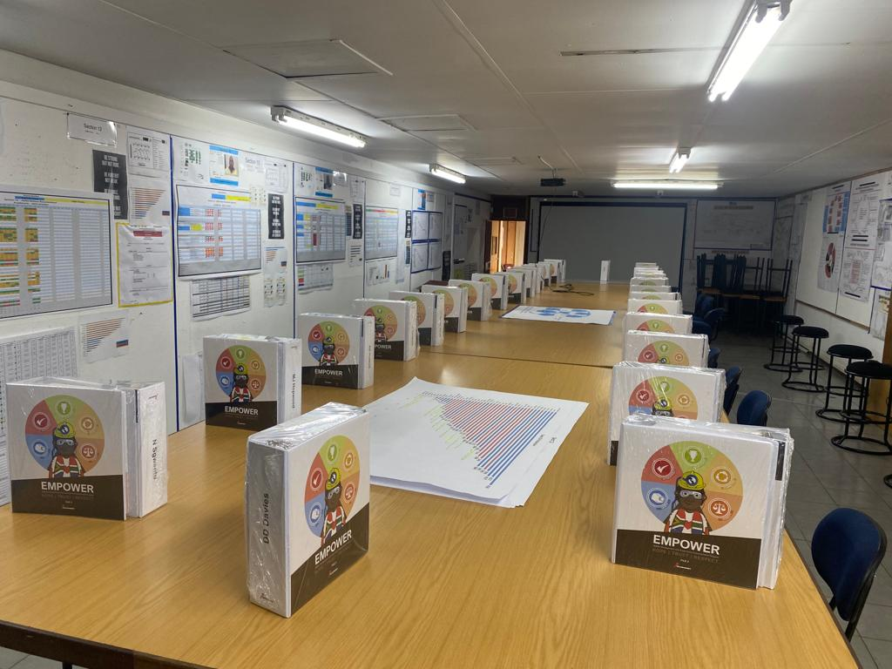
MMSEP
Project | Current status | Comments | Status
MMSEP | Project Kick-off commenced with engagement sessions held with line supervisors Middle Management empowerment session scheduled 18th October Leader as coach session held 25th October Roll-out Q1 FY24 | Work file completed Engagement process commenced Focus on coaching and empowerment process Planning module to be done to reinforce quality planning intervention

Slide 7
MMSEP
Project | Current status | Comments | Status
Face time optimization | Shaft cage times, clocking windows revised and carriages times aligned. | Gained one hour on times resulting in better quality face time. With facial recognition and the times are expected to improve more going forward. Monitoring is ongoing to keep focus there

Slide 8
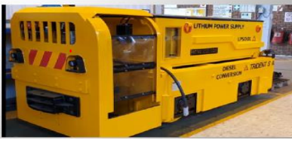
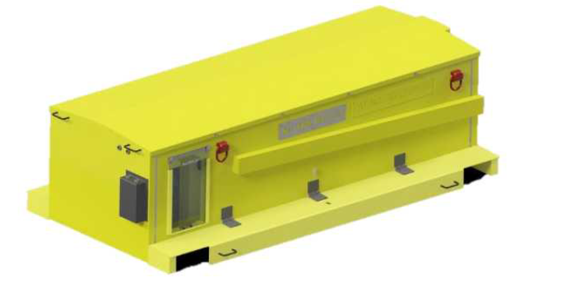
Lithium Loco Batteries
Challenge:
We foresee logistical constraints on 109 Level and 113L with tramming. (congestion at battery bays with 20 locos changing batteries)
Solution/Benefits:
Lithium batteries give us the opportunity to charge in strategic places and no need to change batteries.
Quick Shift transportation with man-carriages.
More tramming cycles between charges
Current Status:
4 Batteries commissioned on 109 Level
4 Batteries commissioned on 113 Level
Remote monitoring of battery status still to be implemented

Slide 9
1. Provision of a healthy and safe working environment
1.3 S 300 – 26°C@15m³/s Intake Temperatures action plan
Item | Location | Action | Benefit | Status
Point 1 | 113L XC38 | Investigate BAC performance and monitor sealing plan. | Improved BAC performance and reduce 113L XC38 intake temperature | Ongoing
Point 2 | 113L XC27S | Address footwall water by monitoring pumps on 113LE. | Reduce temperature at 113L XC27 by limiting heat transfer between stagnant footwall water and ventilation air. | Ongoing
Point 3 | 98L XC15 | Sealing plan, seal of 98L XC19 and 98L XC24. | Increase quantity at 98LE XC15 to increase air cooling power and in turn 98L XC15 temperature. | Pending
Point 4 | 102L XC15 | Seal 102L XC18. | Increase quantity at 102LE XC15 to increase air cooling power. | In progress (mid March)
Point 5 | 113L XC26S | Regulate intake quantities at 113LE XC30S, XC29N, XC29S, XC33 and XC35 | Increase quantity at 113LE XC26S to increase air cooling power and in turn 113L XC26S temperature. | Pending
Point 6 | 105L XC17 | Install 500kW Cooling car. | Reduce Intake temperature. | Planned 10/03/2024
55% of Working Places < 26°C

Slide 10
1. Provision of a healthy and safe working environment
1.3 S 300 – 26°C@15m³/s Intake Quantity action plan
Item | Location | Action | Benefit | Status
Point 1 | 105L XC17 | Disconnect 102L XC17 15kW fan in order to increase flow from bottom and seal 105L XC18. | Increase available quantity for 105L XC17. | 09/02/2024
Point 2 | 102L XC15 | Seal 102L XC18. | Increase available quantity for 102L XC15. | 12/02/2024
Point 3 | 105L XC27 | Seal 105L XC18. | Increase available quantity for 105L XC27. | 12/02/2024
Point 4 | 113L XC32 | Regulate 113L XC30S and 113L XC29N. | Increase available quantity for 113L XC32. | 09/02/2024
Point 5 | 109L XC21 | Installation of 2x 45kW exhaust fans on 98L XC21. | Increase pull at 109L XC21. | Completed installation Re-audit area
75% of Working Places > 15 m3/s

Slide 11
Energy : Power SAVING INITIATIVES
Energy saving initiatives:
Compressed Air
Air valve REMS control
Compressor setpoint and consumption reduction
Pumping
Return water system control
Water valves to mining REMS control
Pumping load shift and reduction
Refrigeration
Underground refrigeration load shifts
Surface refrigeration load shift
Main Fans
Surface fan IGVs installed
Hoisting
Sub Shaft and Surface rock winder load shift
Energy saving initiatives planned FY24:
29L turbine refurbishment in progress
92L turbine refurbishment commissioned
*YTD Energy Savings R14m

Slide 12
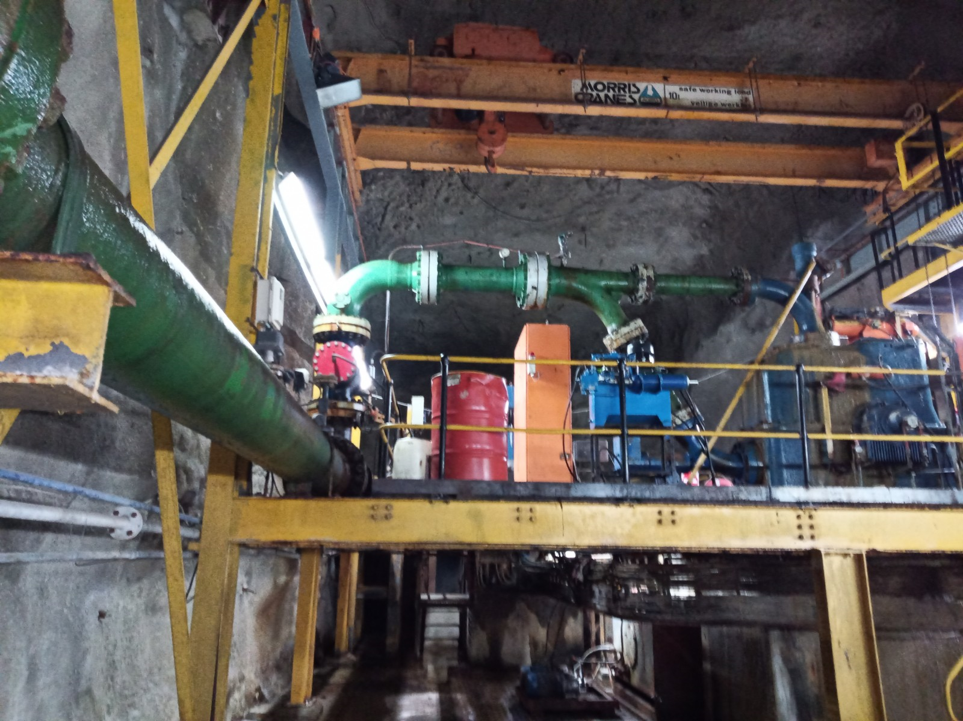
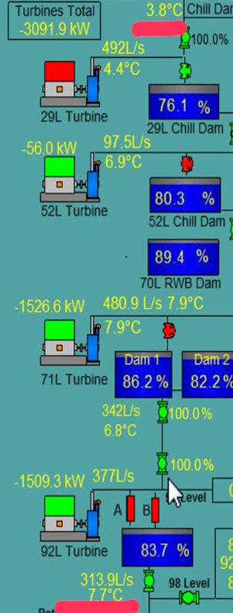
Energy : turbines (R4.0M Saving)
Turbine project savings
Turbine power generated
1
2
1
Expected savings for 29L, 52L, 71L, 92L turbines
(R5.0M monthly)
29L turbine expected to be operational April 2024
52L, 71L & 92L turbine operational
Decrease water temp to mining (-1.5°C)
2
P
3
3
4

Slide 13
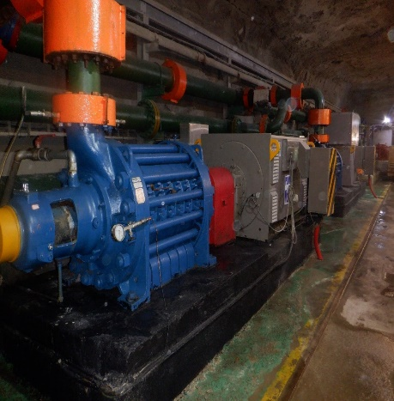
ENGINEERING INFRASTRUCTURE: Pump Life
1
115L - 2off pumps changed (12115hrs)
MM shaft - 2off pumps changed (21756hrs)
3
Key Points
1
MM shaft - 2off pumps changed (21756hrs)
115L - 2off pumps changed (12115hrs)
Less pump failures, Pumps changed to normalize to 4-6 pumps per year
Reduced Balance Disc wear
Good water treatment
2
3
2

Slide 14
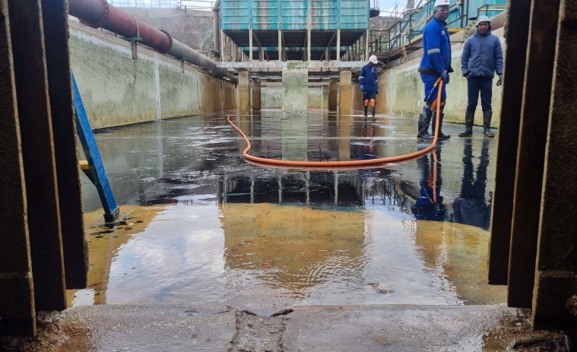
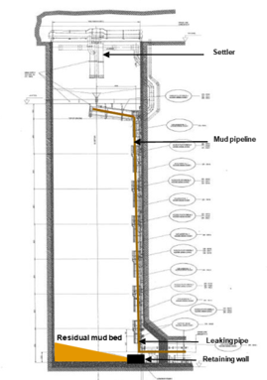
ENGINEERING INFRASTUCTURE – DAM CLEANING
Dam Cleaning Plan
2023 Plan | Actual | Progress | Action
16 Dams planned | 16 Dams |  | Surface dams, Compressors, 29L Dam 2, 71L Hot dam, 95 Dam and 115L Dam 3 cleaned during Dec Break Cleaning schedule in place (DMS)
P
Further reduced Mud on Surface dams when compared to previous years
2023 Plan | Impact | Progress | Action
29L Hot Dam 1 & 2 | Reduced pump life |  | Dams cleaned individually as per schedule in place (DMS)
52L Hot Dam 1 & 2 | Reduced pump life |  | Dams cleaned individually as per schedule in place (DMS)
75L Hot Dam 1 & 2 | Reduced pump life |  | Dams cleaned individually as per schedule in place (DMS)
100L Hot Dam 1 & 3 | Reduced pump life |  | Dams cleaned individually as per schedule in place (DMS)
115L Hot Dam 1 & 3 | Reduced pump life |  | Dams cleaned individually as per schedule in place (DMS) Continue cleaning dam during Engineering Weekends
P
P
P
P
P

Slide 15
Shaft Performance
Area mined (m²)
1
2
Loss of life incident 5th September 2023
Seismic event 0.3 magnitude in a dyke intersected by the 113L haulage
Subsequent south side wall ejection
Impact of slow start up post December break
Fire incident
Key Points
1
2
Tonnes Milled (t’000)
1
2

Slide 16
Shaft Performance
Quarter on Quarter
Year on Year
Gold Produced (kgs)
Recovered Grade (g/t)
Production Cost (R/kg)
Contribution (Rm)
Gold Produced (kgs)
Recovered Grade (g/t)
Production Cost (R/kg)
Contribution (Rm)

Slide 17
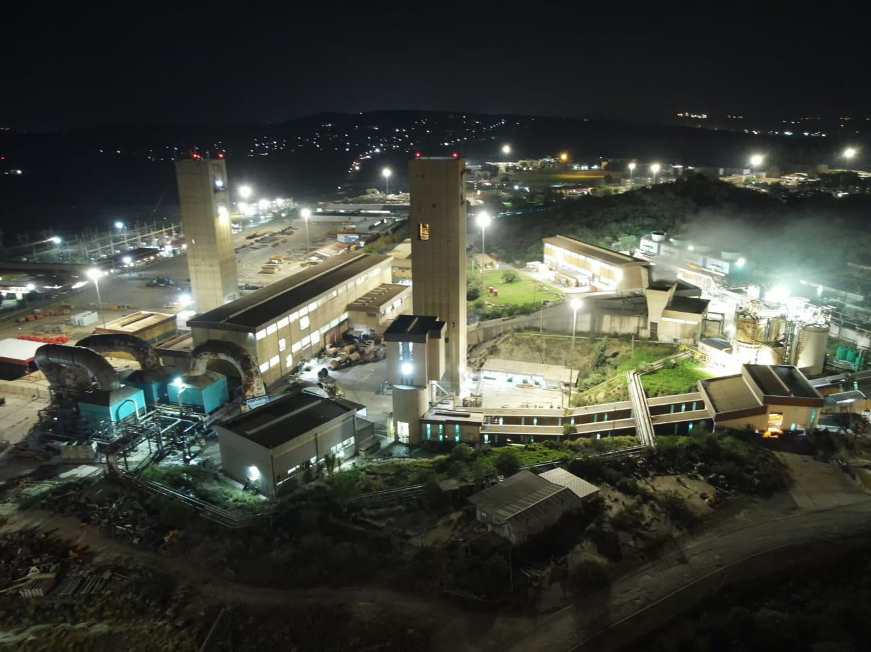
END
17
Note: Place to add Mine specific photo, if the team wants to do so

